Slide 1
CRM Project
GROUP 5:
Mr.Hemant Dhaked
Miss. Hemaa Nandini
Mr . Tharun Dommeti
Mrs. S.R. Lalitha
Mr. Laxman Kumar

Slide 2
OBJECTIVES
LEAD INSIGHTS:
Lead Kpi’s
Converson Kpi’s
LEAD - Comparision by SOURCE & INDUSTRY
OPPORTUNITY INSIGHTS:
Opportunity Overview
Opportunity Report - 1
Opportunity Report-2
Trend Analysis Over Time

Slide 3
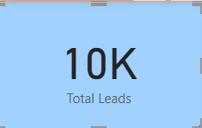
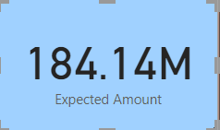
LEAD KPI’s
WE HAVE TOTAL OF 10,000 LEADS IN CRM DATA BASE
THE TOTAL EXPECTED AMOUNT FROM THE LEADS IS $ 184.14 Million

Slide 4
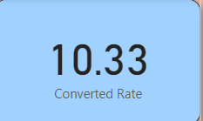
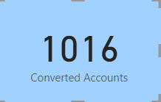
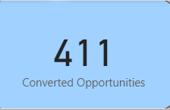
CONVERSION KPI’s
LEADS
The conversion rate from leads to accounts is 10.33%
ACCOUNTS
Total of 1016 Accounts are created from the leads
OPPURTUNITIES
411 Oppurtunites are convereted from Accounts

Slide 5
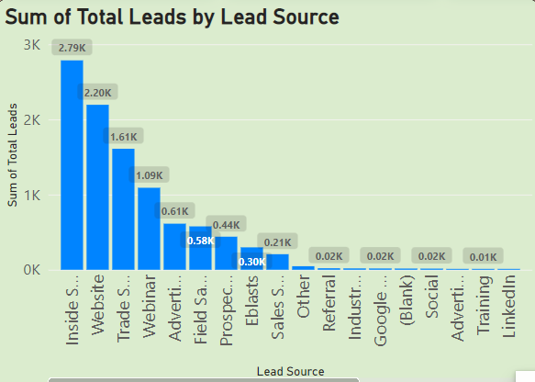
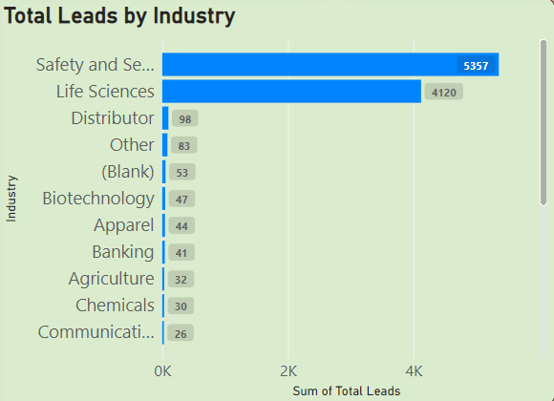
LEADS COMPARISON
BY INDUSTRY
INSIDE SALES gives most of leads
There are 28 types of lead sources
TOP 3 Lead sources are INSIDE SALES, WEBSITE,TRADE SHOW.
From Safety and security industry we got most of the Leads
There are 21 types of Industries
Safety and security, Life Sciences are the Top Industries in producing Leads.

Slide 6


Oppourtunity Overview
The total expected Amount is $184.14 Millions
Total ACTIVE Opportunities are 1272

Slide 7



OPPORTUNITY REPORT-1
The conversion rate of Opportunity is 31.06%
The Win Rate in Conversion is 42.77%
The Loss Rate in Conversion is 57.23%

Slide 8
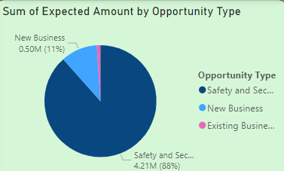
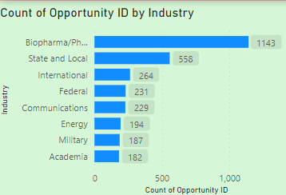
OPPORTUNITY REPORT-2
Most expected amount is from Safety and Security Industry.
4.21 Millions is Highest Expected Amount
New Business, Existing Business and Safety and Security are the different Oppurtunity Types.
Biopharma Industry has most Opportunity ID’s
1142 Opportunity ID’s are created from Biopharma Industry
From 33 Types of Industries we are having Oppurtunities

Slide 9
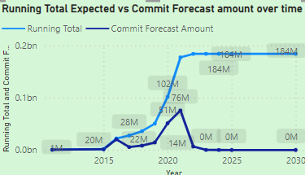
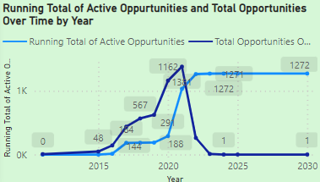
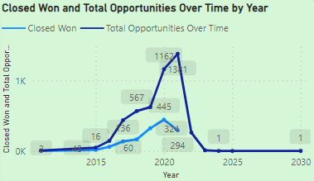
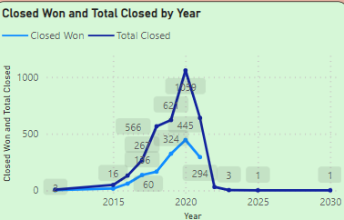
TREND ANALYSIS OVER TIME

Slide 10
THANK YOU

